Slide 1


Css 332
Programming Issues with Object-Oriented Languages
Morteza Chini

Slide 2

Thank you all!

Slide 3
week 3
Autumn 2017
Data Representation,
C-style string, Structs
Presentation material partially borrowed from learncpp.com

Slide 4
Data representation
Digital Number Systems
Decimal Number System/ Base 10 System
Binary Number System
Octal Number System/ Base 8 system
Hexadecimal Number System/ Base 16 System

Slide 5
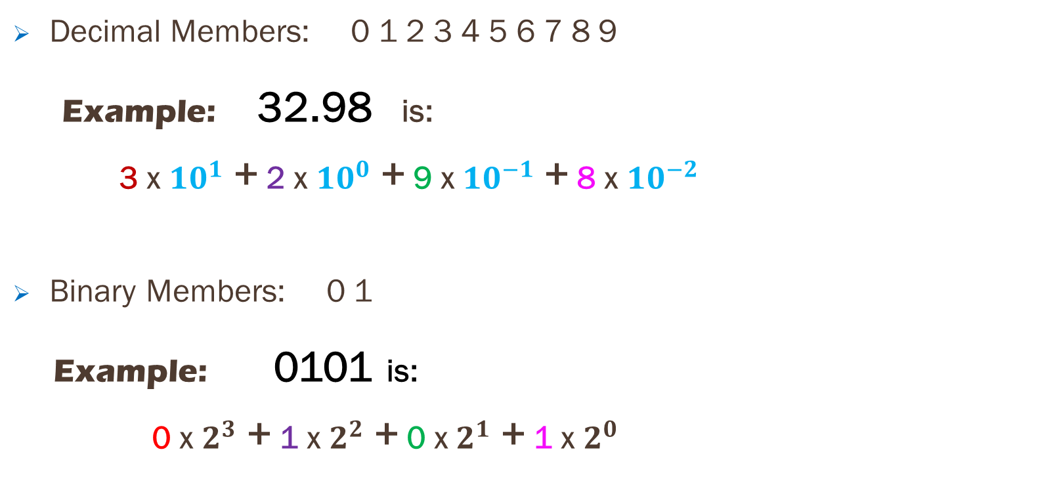
Decimal & binary Number Systems
Decimal Members: 0 1 2 3 4 5 6 7 8 9
Example: 32.98 is:
3 x ${10}^{1}$ + 2 x ${10}^{0}$ + 9 x ${10}^{−1}$ + 8 x ${10}^{−2}$
Binary Members: 0 1
Example: 0101 is:
0 x $2^{3}$ + 1 x $2^{2}$ + 0 x $2^{1}$ + 1 x $2^{0}$
MSB
LSB
MSB = Most Significant Bit LSB = Least Significant Bit

Slide 6
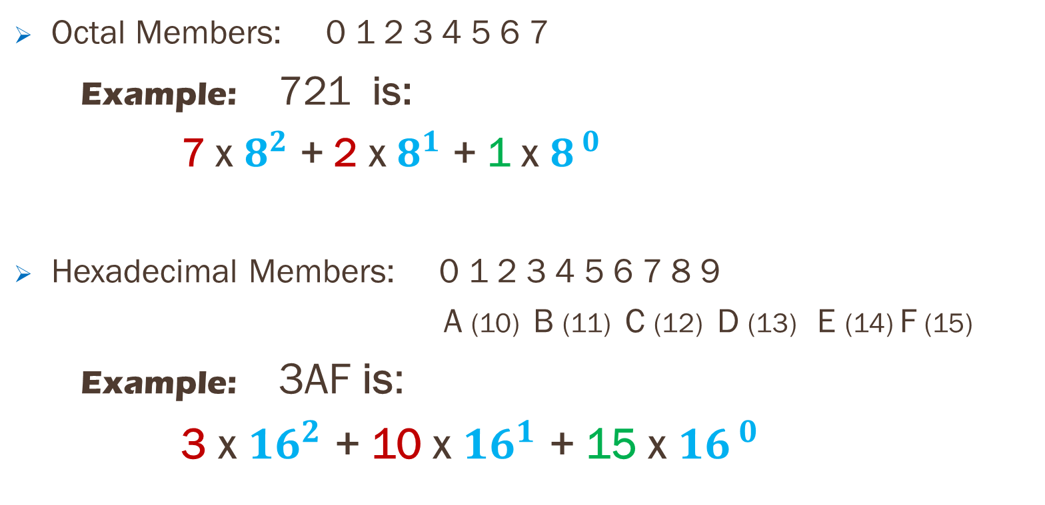
Octal & hexadecimal number system
Octal Members: 0 1 2 3 4 5 6 7
Example: 721 is:
7 x $8^{2}$ + 2 x $8^{1}$ + 1 x $8^{ 0}$
Hexadecimal Members: 0 1 2 3 4 5 6 7 8 9
A (10) B (11) C (12) D (13) E (14) F (15)
Example: 3AF is:
3 x ${16}^{2}$ + 10 x ${16}^{1}$ + 15 x ${16}^{ 0}$

Slide 7
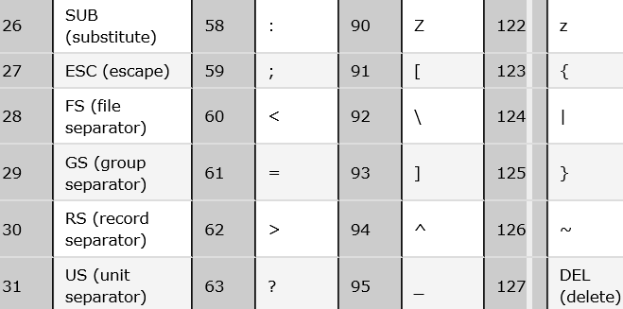
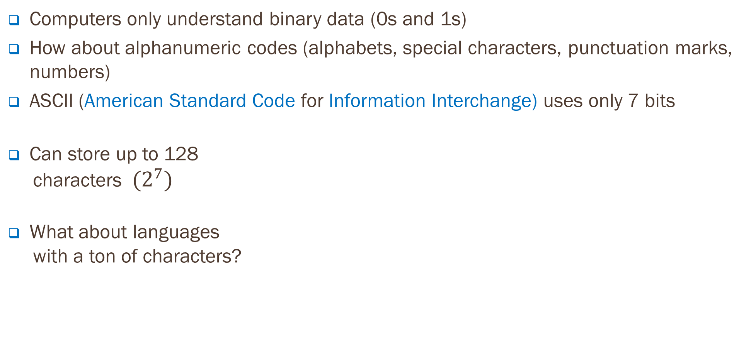

Ascii code to represent non-binary data
Computers only understand binary data (0s and 1s)
How about alphanumeric codes (alphabets, special characters, punctuation marks, numbers)
ASCII (American Standard Code for Information Interchange) uses only 7 bits
Can store up to 128
characters${ (2}^{7})$
What about languages
with a ton of characters?
$$2^{8}$$
$$2^{7}$$ | $$2^{6}$$ | $${2 }^{5}$$ | $$2^{4}$$ | $$2^{3}$$ | $$2^{2}$$ | $$2^{1}$$

Slide 8

C-style strings
String is a collection of sequential characters “Hello, world!”
We use std::string (part of the standard library) when working with strings in C++
std::string, however, is implemented using C-style string
A C-style string is simply an array of characters that uses a null terminator
(‘\0’, ASCII code 0)
A C-style string is also called a null-terminated string
Declaring a char array and initializing it with a string literal will give you a C-style string
char mystring[] = “Hello";

Slide 9
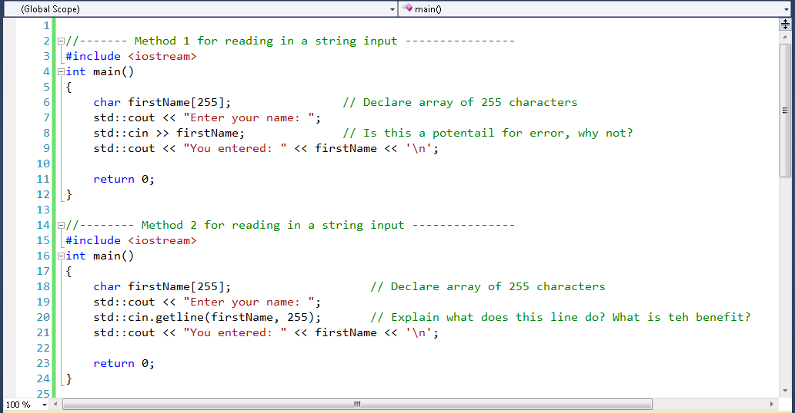
C-style strings & cin >>

Slide 10
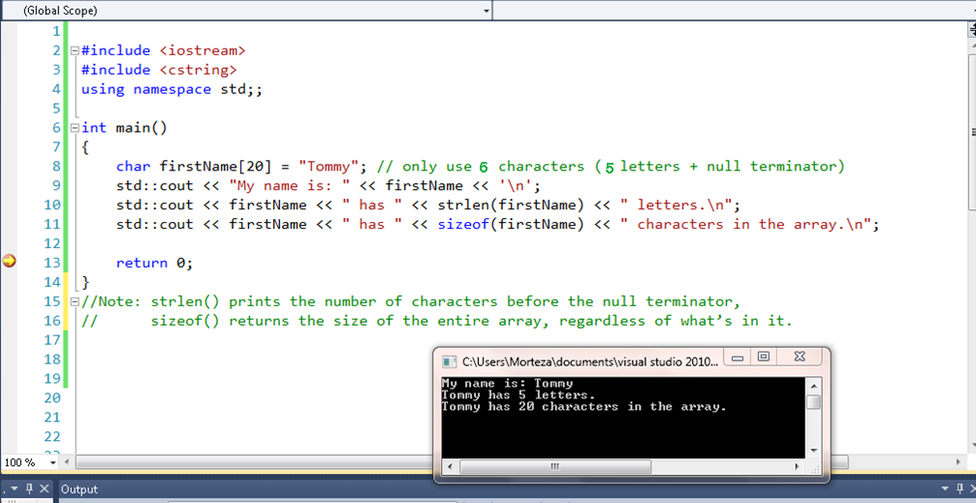
Strlen() vs. sizeof()

Slide 11
C string Best practice
Some useful string functions:
strcat() Appends one string to another (dangerous)
strcat(destination, source); strncat() Appends one string to another (buffer length check)
strncat (destination, source, size); strcmp() Compares two strings (returns 0 if equal) strncmp() Compares two strings up to a specific number of characters
(returns 0 if equal)
Now that you know all about C-style string, avoid using it all together!
std::string is easier, safer, and more flexible. #include <string>

Slide 12
OOP, revisited!
In C++ an object is a chunk of of memory that is used to store complex/user defined values
If you give your object a name, then it is called a variable
OOP: objects are everywhere: cars, chairs, students, PCs, etc.…
Major components of objects:
1) A number of relevant properties (weight, color, size, shape, etc.…) aka data
2) Some number of behaviors that they can exhibit (e.g., moving, folding, making noise, etc.…)
These properties and behaviors are inseparable. Objects encapsulate both data/status & behaviors into a self-contained, unit of code to manage complexity

Slide 13
access Specifiers
What is an access specifier?
Provides different levels of access to the members
What is a public member?
A class member that can be accessed by anyone
What is a private member?
A class member that can only be accessed by other members of same class
How many access specifiers are there; what are they?
Three; public – private – protected
What is the default access specifier for C++ class members?
It is private

Slide 14
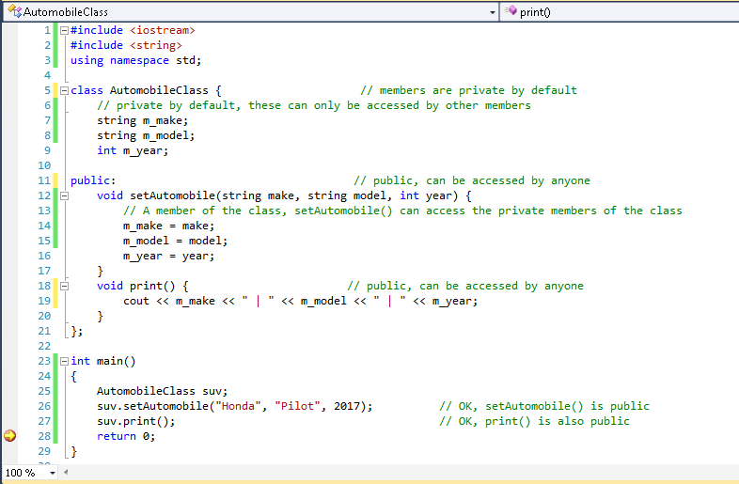
access Specifier: Public vs. private

Slide 15
Type conversion
We know that a value of a variable is stored as a sequence of bits, depending
on data type
Different data types may represent the “same” number differently -- for example, the integer value 12 and the float value 12.0 are stored as completely different binary patterns
What happens here?
float fValue = 7; floating point variable given integer
Compiler can’t just copy the bits representing the value 7 into float fValue. Instead, it needs to convert the integer value to a floating point value. Converting from one data type to another is called a type conversion

Slide 16
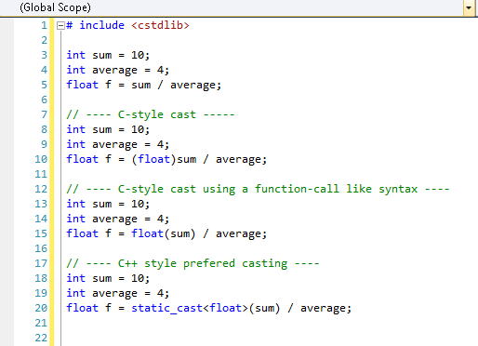
C++ 5 different types of cast
C-style casts, static casts, const casts, dynamic casts, and reinterpret casts

Slide 17
What type of casting?
Is this safe? Explain why?
char ch = static_cast<char>(51);
Unsafe, but programmer communicates to the compiler that he/she is aware of potential pitfalls (int 4bytes, char 1 byte)
Casting presents the potential for trouble. Try to avoid it if possible.
Utilize C++ static cast instead of the C-style casts
What’s the difference between implicit and explicit type conversion?
Implicit -- is done by compiler when it is given 2 different types that do not match
Whereas explicit -- the user implements a type cast operator to convert from one type to another

Slide 18
C++ Struct, An aggregate data type
Often we need more than one variable to represent an object; consider your student info
struct Student
{
short id; member/field
string major; member/field
double GPA; member/field
} ;
Student Anne = { 17542654, CSSE, 3.85 }; using initializer list
Student Thomas = { 1641586, EE } using initializer list
Student John;
John.id = 1585974; initializing using member operator(.)
John.major = “CSSE”;
John.GPA = 3.9;
Note the semi-colon

Slide 19
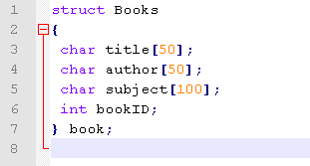
another option to Define a struct
The struct name (Books) is optional; also, before the final semicolon, you can specify one or more struct variables but it is also optional

Slide 20


Structs vs. individual variables
Advantage 1) Pass the entire struct to a function that needs to work with the members (joe instance of struct)
Advantage 2) Have a function return a struct, which is one of the few ways to have a function return multiple variables (Point3d is a struct)

Slide 21
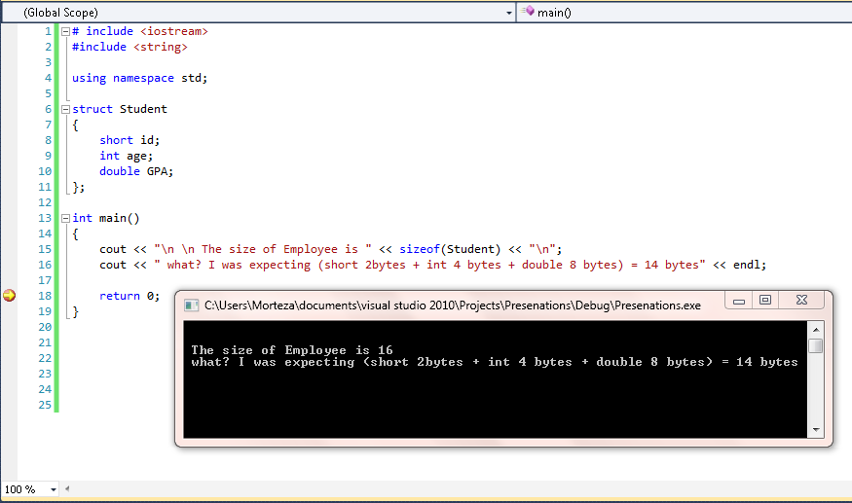
Struct size & padding phenomenon

Slide 22
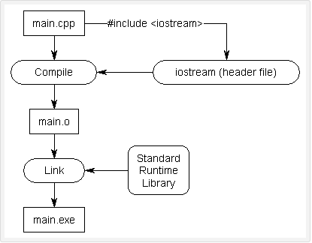
.h files & their purpose
C++ code files (.cpp) hold the implementation of functions for C++ programs. The other type of file is called a header file (.h), where the member function declarations live; providing a way to separate implementation from definition
As programs grow more
complex and larger and
include more files, it becomes
increasingly hard to have to
forward declare all functions
you want to use located in
different files, .h files make it
easy to reuse code.

Slide 23
Header guards / #pragma directive
Header guards prevent a code file from receiving more than one copy of a guarded header
Header guards do not prevent a given header file from being included (once) into different code files
#ifndef SQUARE_H
#define SQUARE_H
//Declarations and definitions can go here
#endif
#pragma once
A simpler, shorter solution supported by most compilers #pragma directive

Slide 24
There are two ways to write error-free programs; only the third one works.
(Alan J. Perlis)

